Slide 1







Systems Thinking, Systems Mapping, and Systems Leadership
Drek Cabrera, PhD
Laura Cabrera, PhD
Cornell University
Cabrera Research Lab
Plectica
dac66@cornell.edu
lac19@cornell.edu
RESEARCH SUPPORTED BY:
Notes:
Thanks for having us today.

Slide 2
How do you do systems thinking in organizations?
Notes:
Over the last 10 years, Laura and I have spent time researching this question. We have found that systems thinking and systems and problems that people are dealing with are quite complex. So, although all of the thinking can occur in your head,
it often needs to be laid bare (captured)
it often needs to be shared and worked on together in groups; (communicated, collaboration)
and it often evolves over time. (evolved)

Slide 3
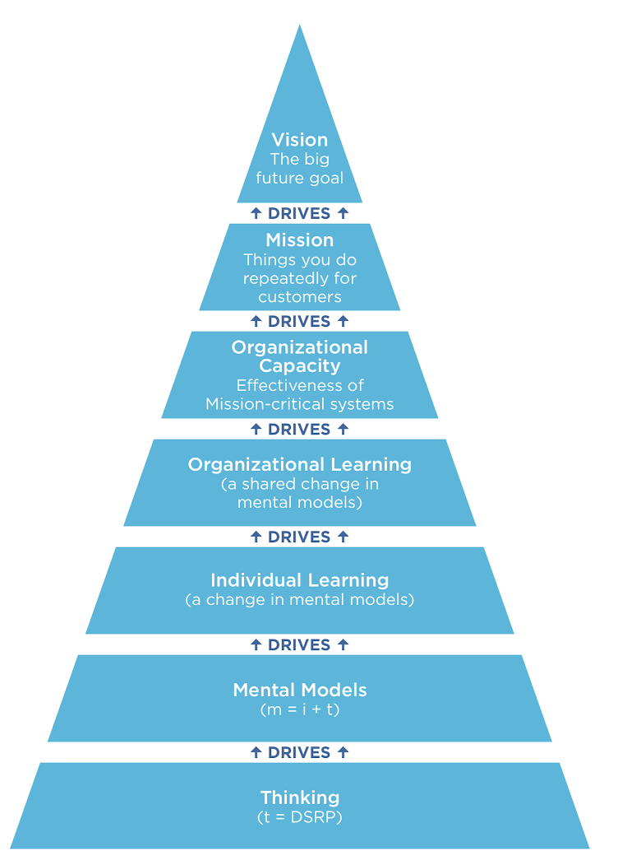


Systems Leadership
“Leading organizations to behave more like superorganisms that self-organize, learn, and adapt to their changing environment.”
Systems Thinking/Mapping
“Thinking in more complex and robust ways to include context, webs of causality, multiple perspectives, etc.”
Notes:
SO we have been talking a lot about ST at individual level, now we’re gonna shift to ST at an organizational level.

Slide 4
 | local agents | + | simple rules | ⭆ | emergent behavior
Systemic Thinking (cognition) | Information (manipulable informational variables) |  | “DSRP” Distinctions Systems Relationships Perspectives |  | An adaptive thinker capable of solving tough problems by thinking in more complex and robust ways to include context, webs of causality, multiple perspectives, etc.
Adaptive Organizations | People/ employees |  | “VMCL” Vision Mission Capacity Learning |  | An organization that behaves like a superorganism: that self-organizes, learns, and adapts to its changing environment.
Notes:
Derek walked you through ST as a CAS with its simple DSRP rules, and that same CAS algorithm applies to leading adaptive organizations..
We call these four simple rules of orgs VMCL.
It’s important to note that every organization ---your organizations--- are CAS’s by nature bc ALL human organizations are complex adaptive systems (CAS).
You don’t get to choose whether or not it is. It just is.

Slide 5

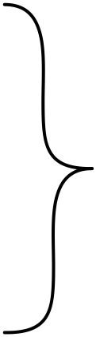
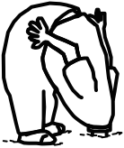
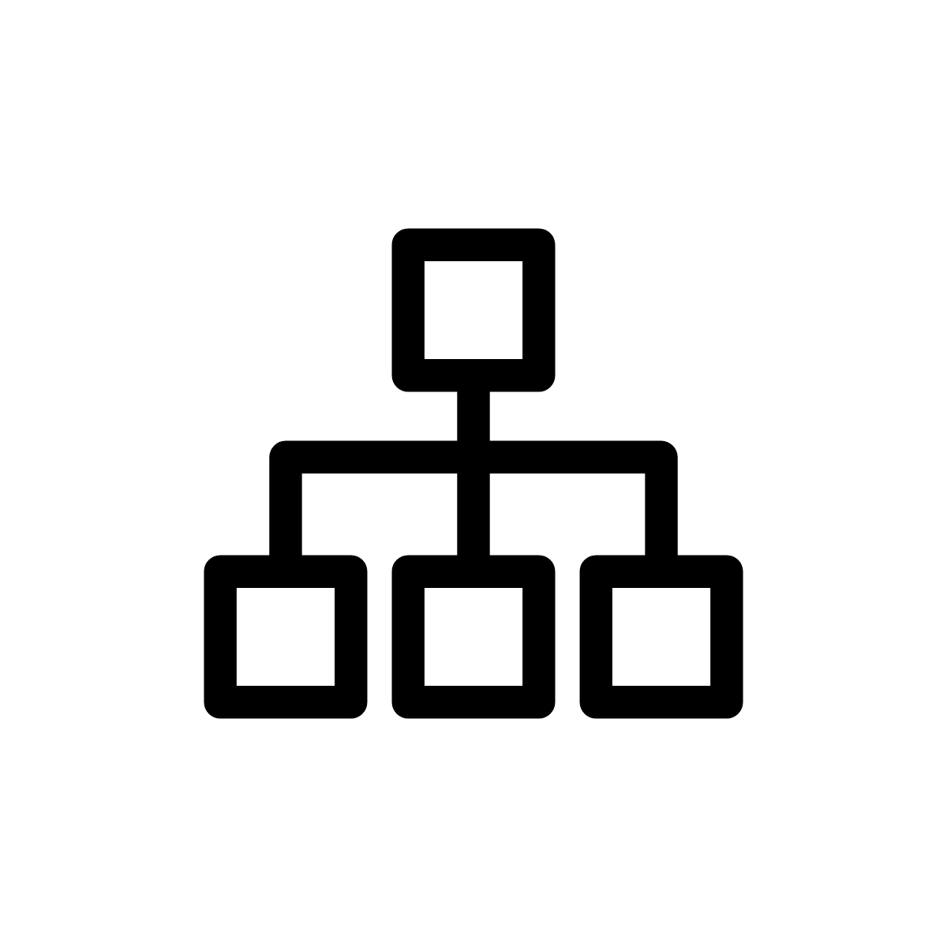


PLAN
feel in control of process
COMMAND
CONTROL
unhappy with results
UTILIZE
TRADITIONAL MODEL OF ORGANIZATIONS
Notes:
..we get the results...Then we start to question… our faulty mental models about our organization.
Let’s look at these a bit more in depth...

Slide 6
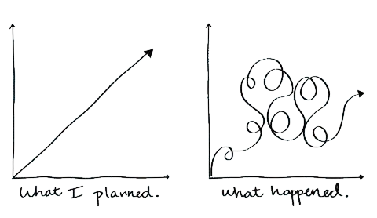
PLAN
Notes:
Planning-
We like to plan, we have strategic plans, 10yr plans, 5 year plans. Quarterly goals, and many more.
But we need to think differently about planning bc what we plan for is often not what happens.

Slide 7
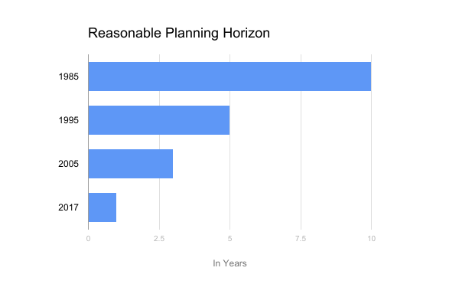
PLAN
Notes:
Over the years, as complexity increases in a vuca world, the horizon for “planning” has shrunk substantially from 10 years to 5 to 3 to one or less. Or quarterly...

Slide 8
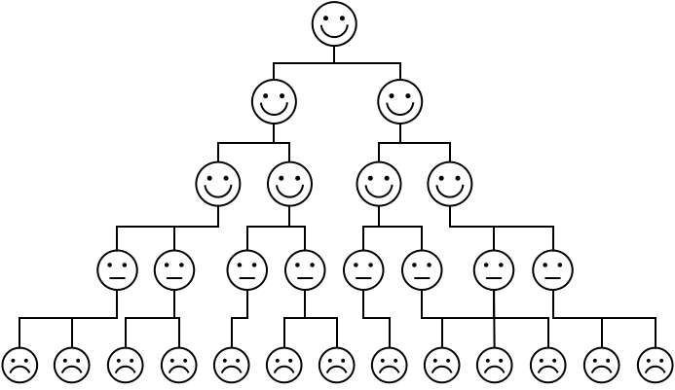
COMMAND
Notes:
We like to feel in command and the simplicity of this mental model comforts us…
We like the idea that command - as a function- simply, trickles down and is executed optimally.

Slide 9
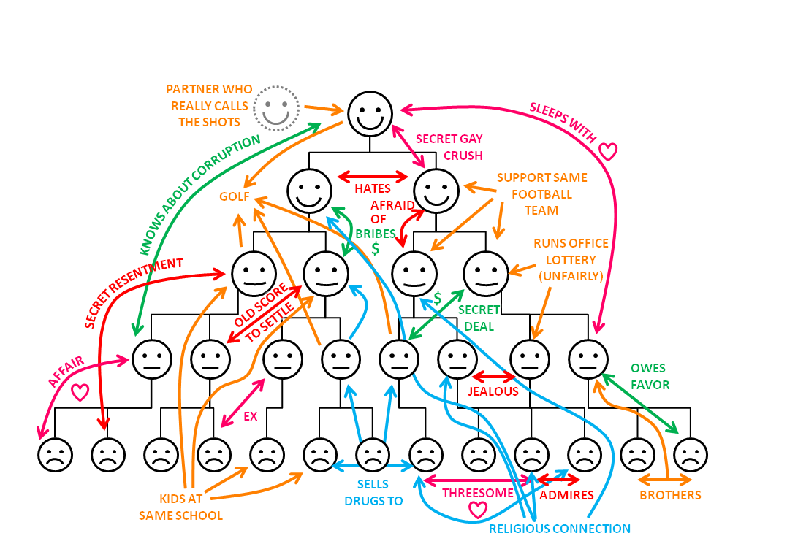
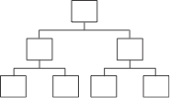
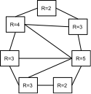
Organizational Chart
Real Organizational Chart
COMMAND
Notes:
Funny slide, but the real point is there are networks formal and informal relationships in orgs, that don’t adhere to a hierarchical tree.
And we will get further if we know this -- and act on this reality.

Slide 10
CONTROL
Notes:
In fact, we so love this hierarchical mental model, that we use it to manage organizational processes, too! We do this By simply...

Slide 11
CONTROL
Notes:
Turning it on its side...and voila! Its a flow chart!

Slide 12
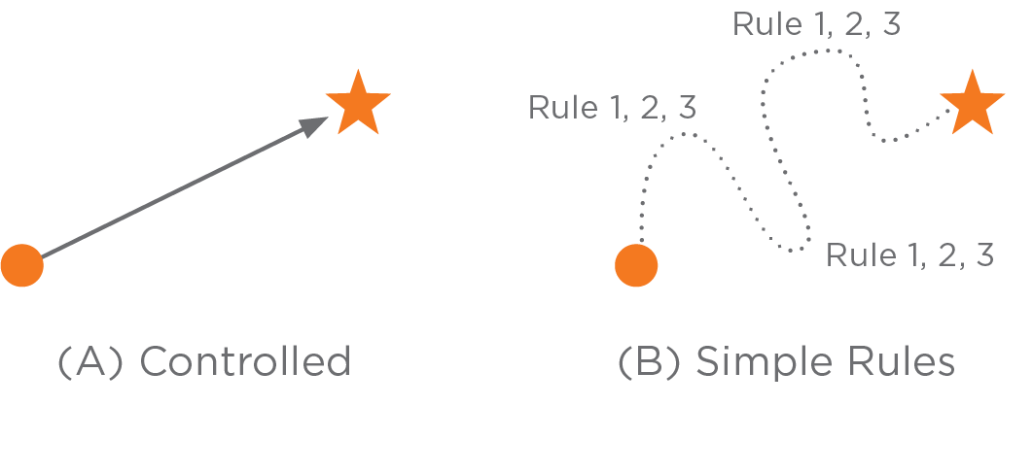
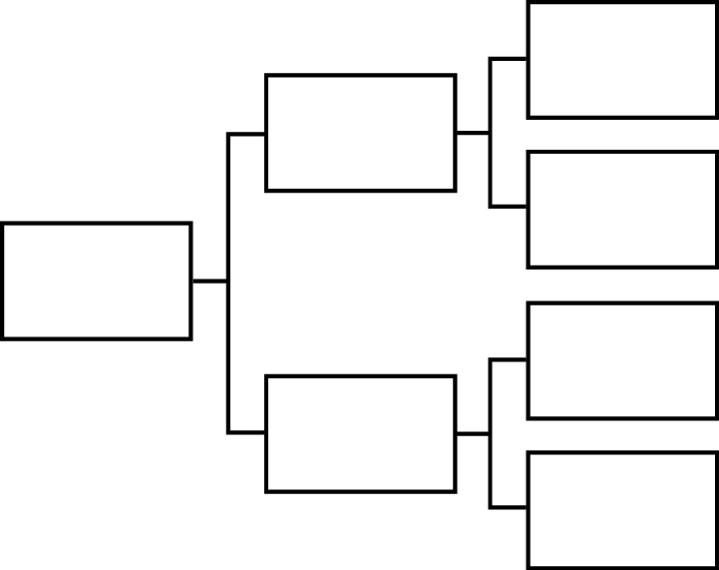
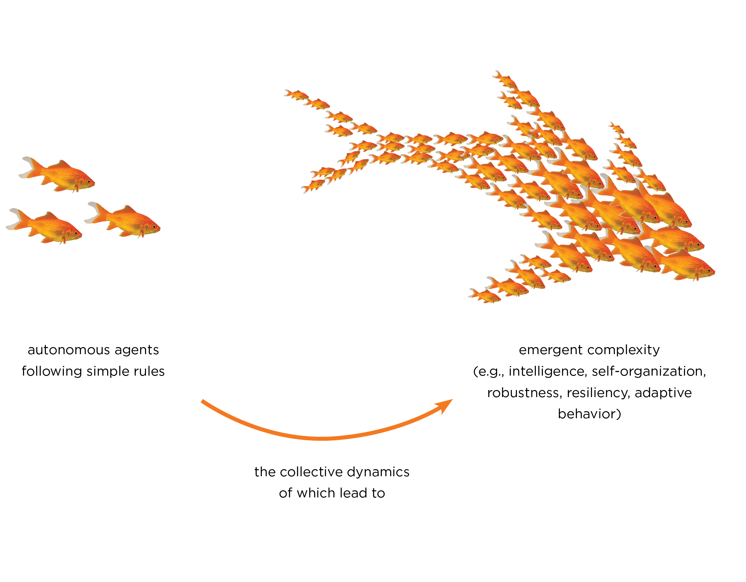
CONTROL
Notes:
But we also need to think differently about processes and controls:
Effective (reality-based) processes require three things:
brutal honesty about our starting point (being data driven about where you really are).
clarity of ending point (vision/goals). Leaders stand in the future and describe what they see
but you must have flexibility and adaptivity in how you get there, which will require knowing the simple rules underlying your work.

Slide 13

UTILIZE
Notes:
This is less of a utilization paradigm and more of a developmental, incentives based, motivational approach to Managing people
Either way, the goal for managing humans, is to leverage the relationships among them to create an agile, superorganism that can adapt when necessary - usually a result of external forces to the org...

Slide 14

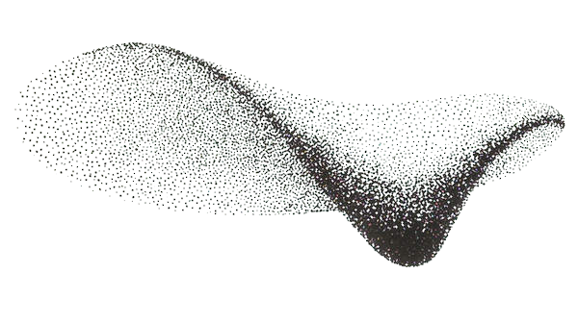

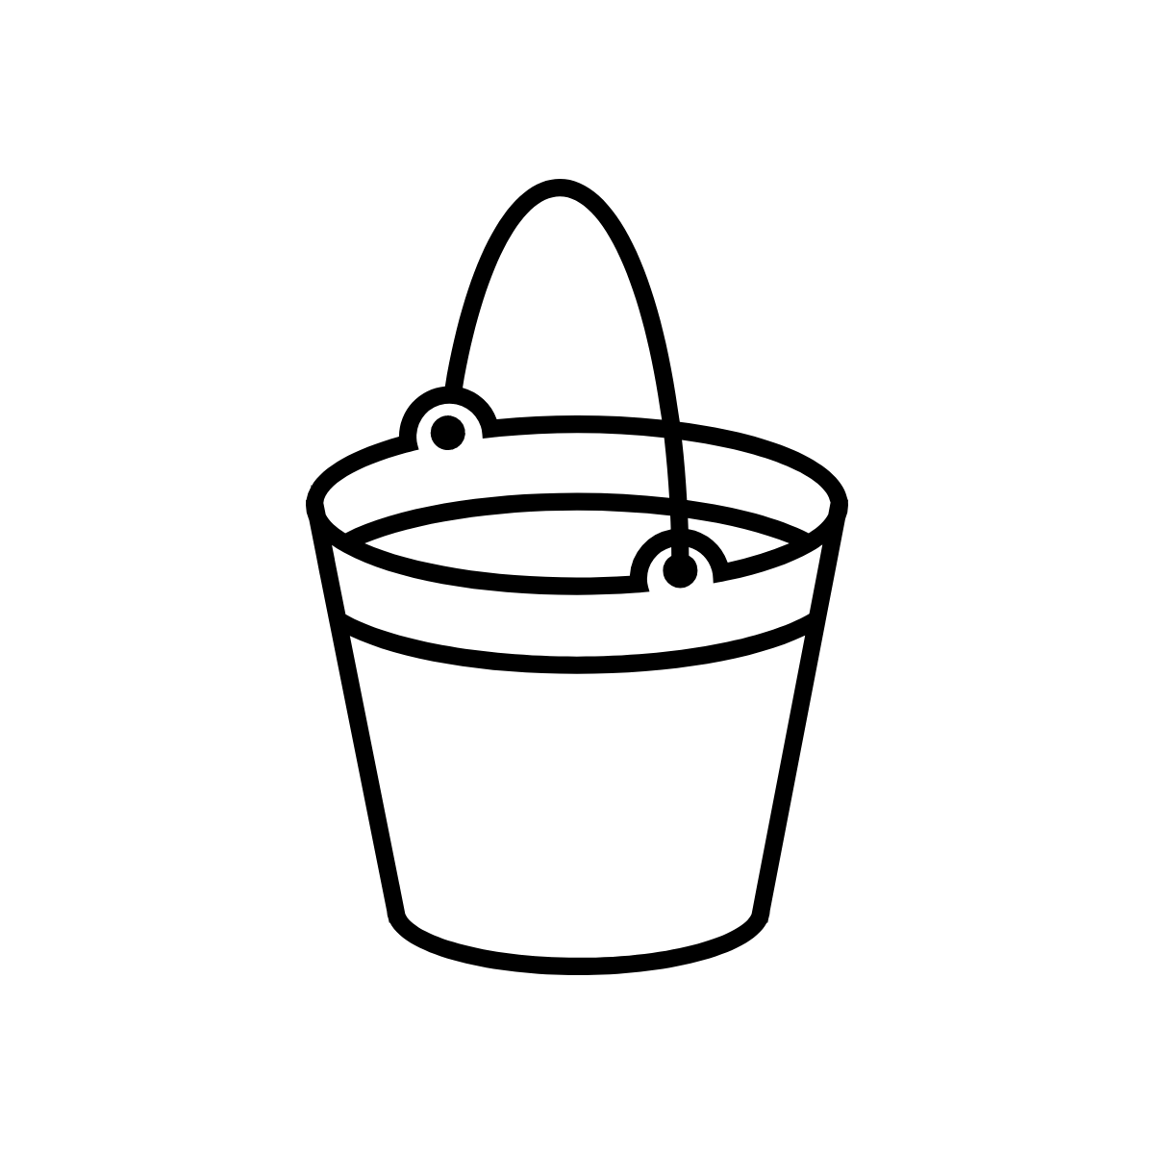

TRADITIONAL “CLOCKWORK” ORGANIZATION MODEL
SYSTEMS “FLOCK-LIKE” ORGANIZATION MODEL
Plan
Vision
Command
Mission
Control
Capacity
Utilize
Learning
Notes:
A traditional organizational model which works against the natural tendencies of the system often leads to muted or unsatisfactory results…
… whereas, leveraging the natural tendencies of a complex systems via simple rules better aligns how we think our org works and how it actually works ---
And then we can have a greater effect on the outcomes we seek.

Slide 15
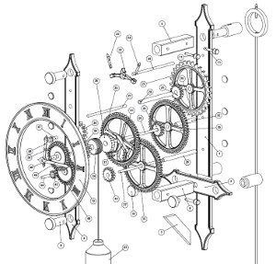
“Build a flock, not a clock.”
Notes:
VMCL replaces this clockwork approach to organizations with a more systemic approach based on Complex Adaptive Systems or CAS
So, the insights I’ll offer you today about VMCL will help you move towards a more reality-based, natural view of your org -- away from a clock-like (mechanistic) metaphor to a flock-like (biological) metaphor of your org.

Slide 16
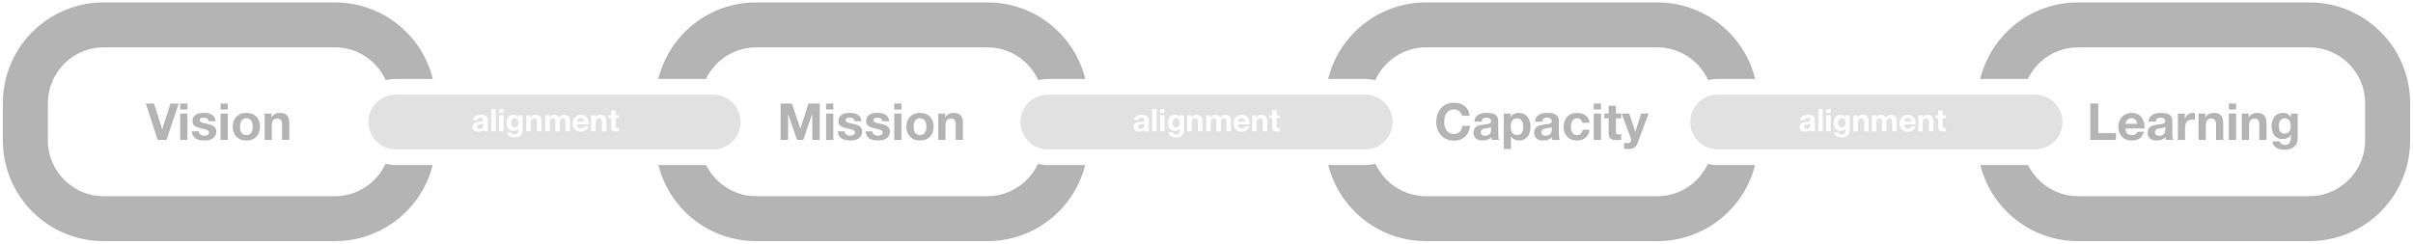
Organizational Function |  | Short definition
Vision (V) |  | Desired future state or goal
Mission (M) |  | Actions that in repetition lead to vision
Capacity (C) |  | Mission-critical systems that support vision
Learning (L) |  | Continuous modification of mental models (DSRP) based on feedback from the external environment
CULTURE |  | Shared mental models (VMCL) that drive organizational behavior
Notes:
also pay particular attention the the power of the alignment among them.
Because this model relies on creating strong bonds between and among these functions.
Of equal importance is CULTURE which sits at the base of these functions --
you must focus efforts on building CULTURE around the four VMCL functions -- the shared mental models that drive your organizational BEHAVIOR
Let me share a bit more about each of these universal organizational functions:

Slide 17
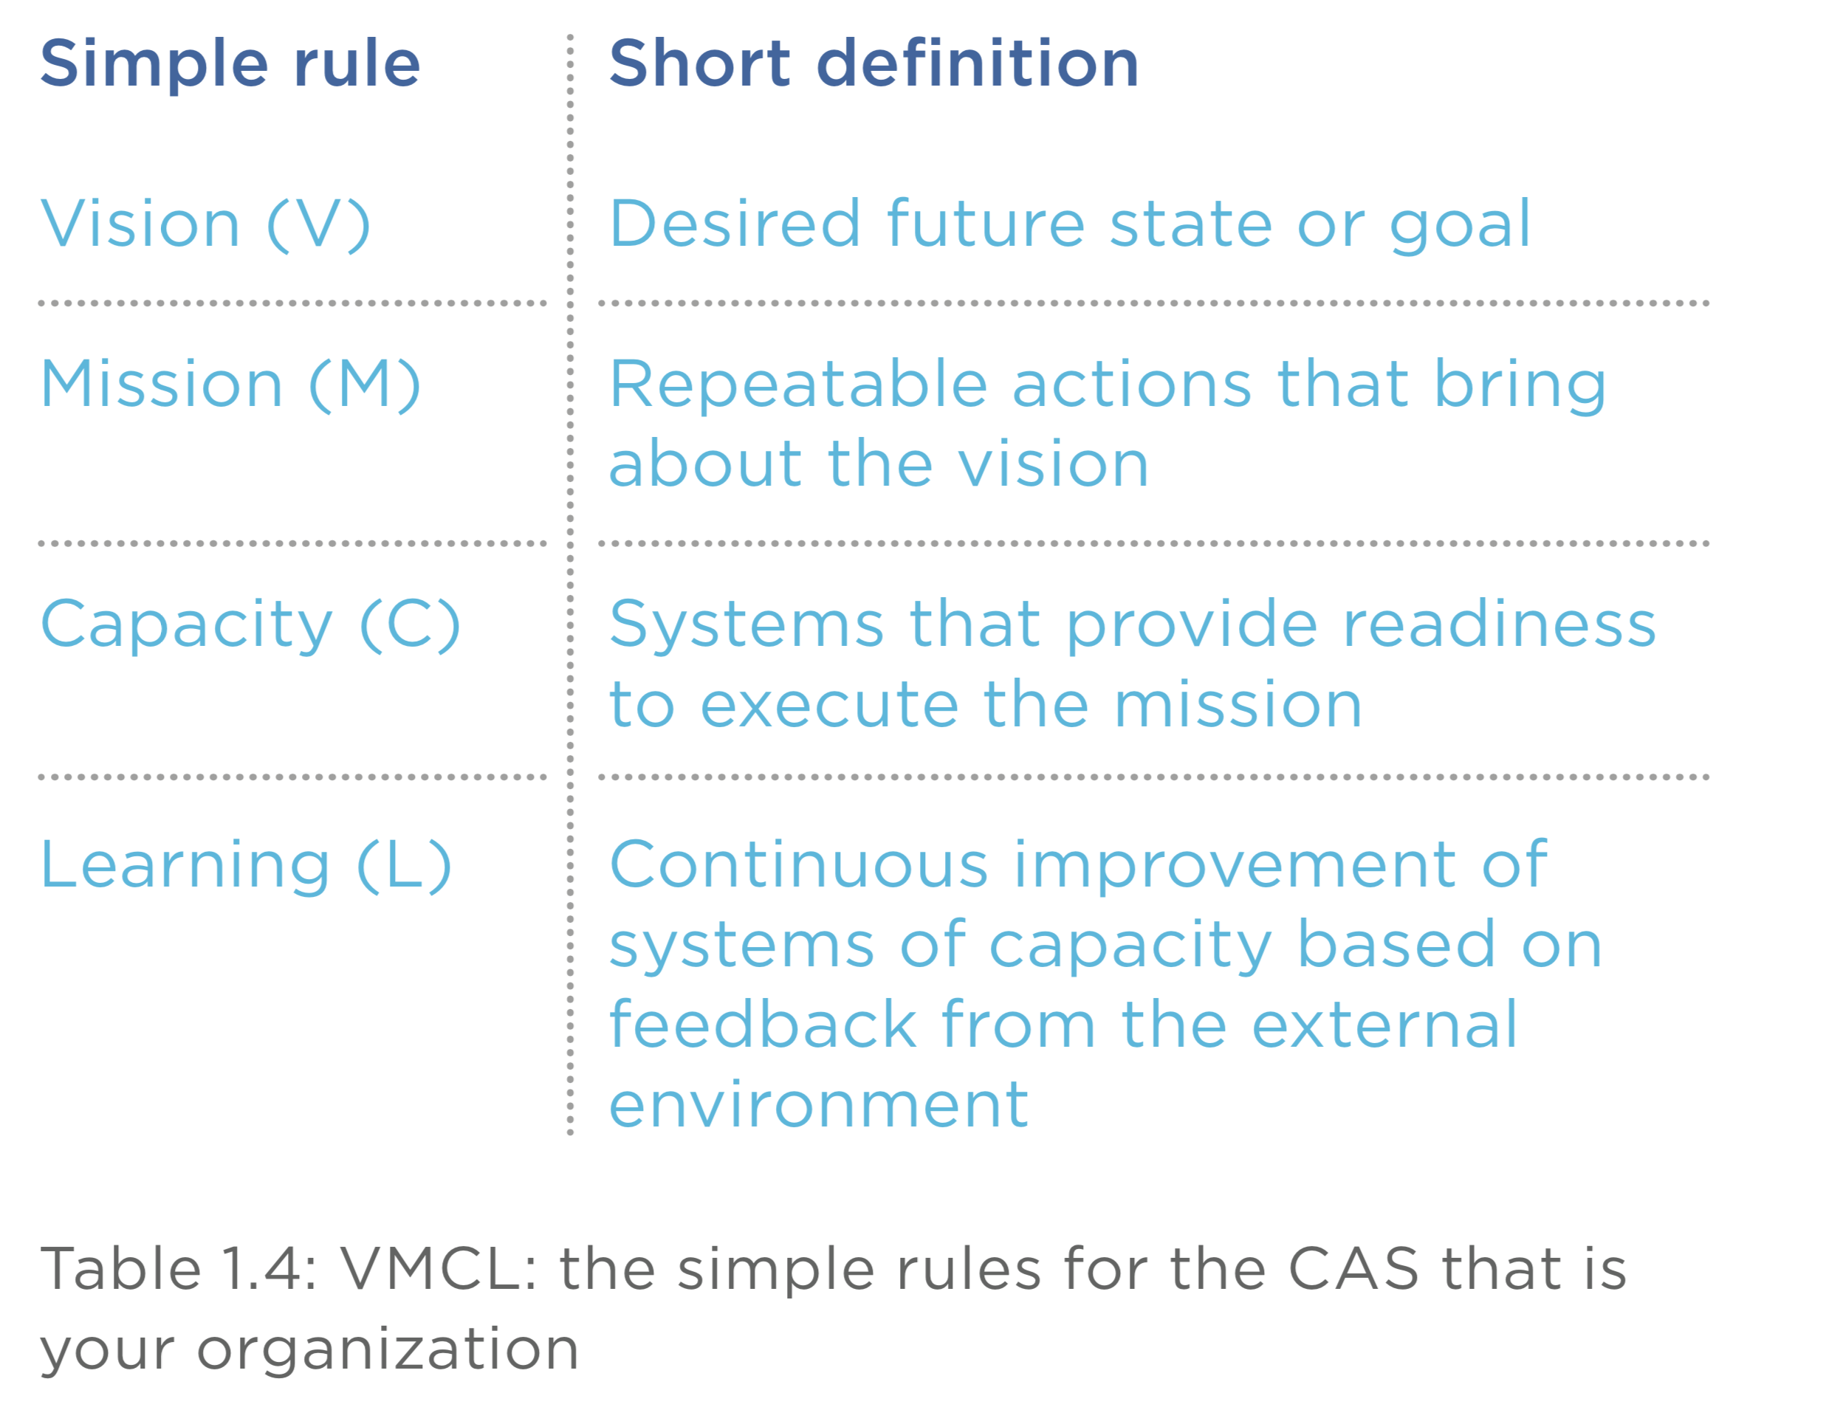
Notes:
Here they are..the simple rules.
Note that there are four critical functions (read slide defs of VMCL)...
also pay particular attention the the power of the alignment among them. You will see that this model relies on creating strong bonds between and among these functions.
At the base of these functions is building CULTURE around them…(read culture definition)
Let me share a bit more about each of these universal organizational functions:

Slide 18
VISION (V)
Notes:
Let’s get started.

Slide 19
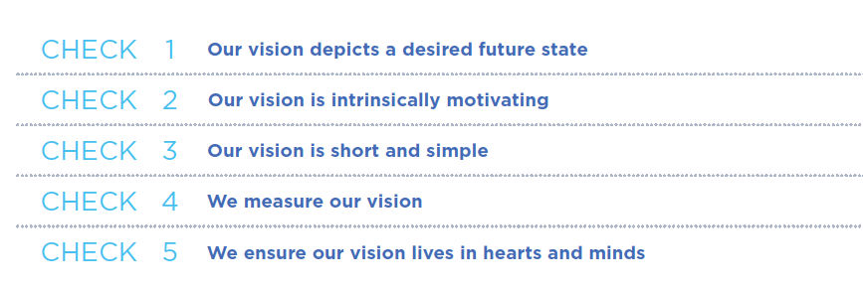
Notes:
5 things about Vision;
Depicts a desired future state;
Intrinsically motivating.
Short and Simple.
Measurable.
Lives in the hearts and minds...

Slide 20
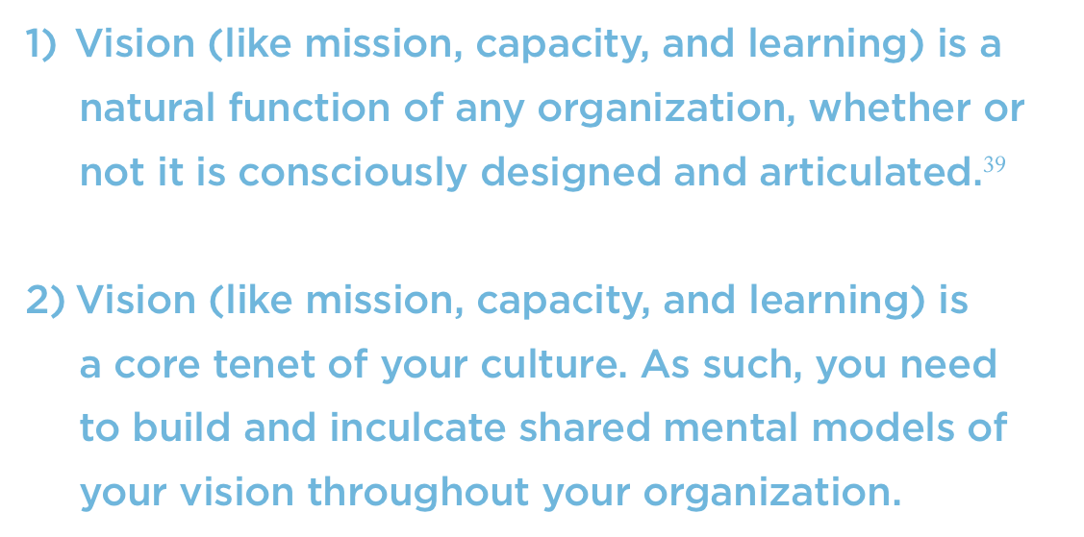
Notes:
Two overarching things about Vision;
It is a NATURAL function of any organization whether or not it is purposefully designed or articulated.
It is a CORE tenet of your culture that MUST BE shared.
In other words, even in a system where no explicit vision has been stated - it will have a goal state - which is driven by its members… POSIWID

Slide 21
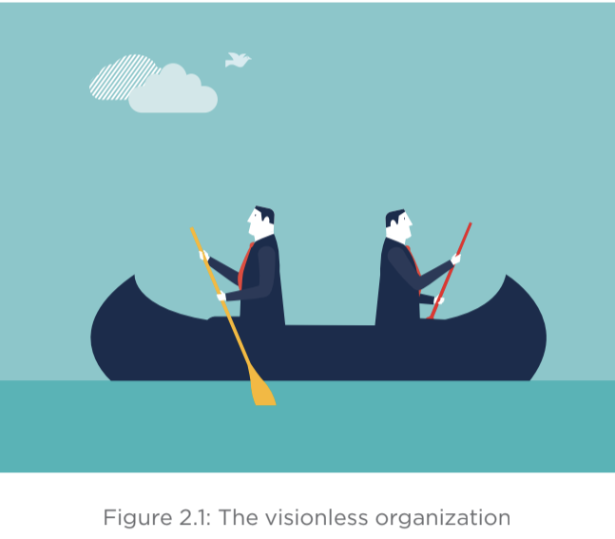
Notes:
Note also that an organization that has 2 (or more) visions…. is a visonless org…
If these two guys have individual vision, then the org vision is the combination of them -- which in effect, cancels out.
these guys will not get very far.

Slide 22
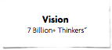
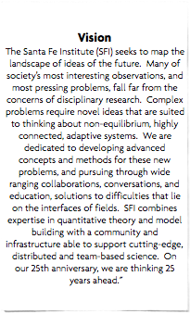
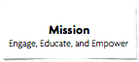

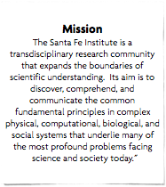
YES
NO
Short and Simple
Notes:
To get these guys on board -- your vision must be simple - it needs to pass the 9 year old test.
Look at these examples, (it’s not important to read them - just look at the SIZE)
how likely is it that you can get an entire organization to understand and know the Vision and Mission on the right?

Slide 23
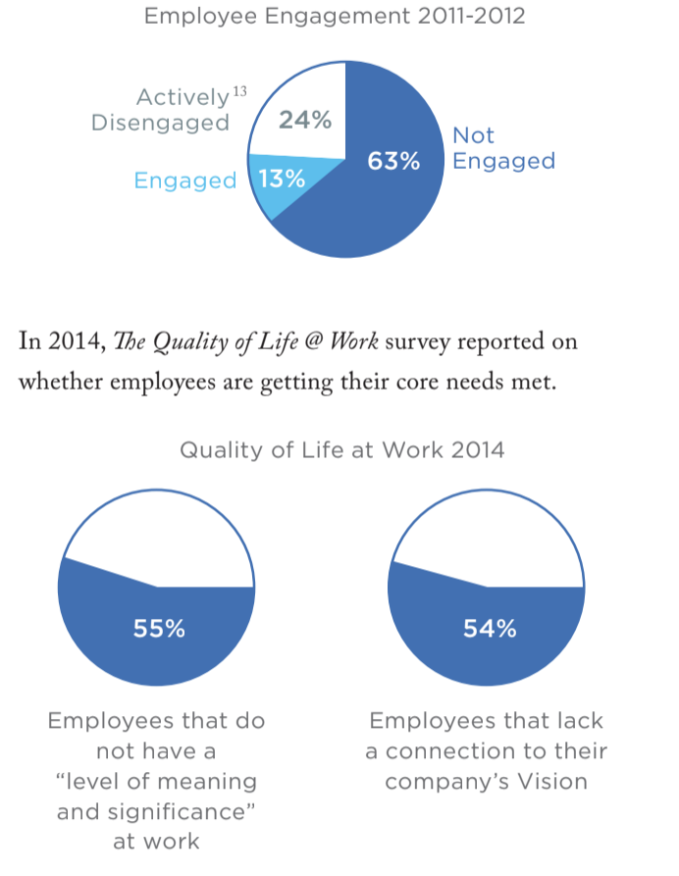
Notes:
Communicating your vision is important, bc your vision affects your employees, and therefore, your organization.
A worldwide Gallup poll that tracked levels of employee engagement reported that the disengaged employees outnumbered engaged employees by about 2 to 1.

Slide 24
Notes:
In 2014, The Quality of Life @ Work survey reported that
Employees who found meaning in their work were:
almost three times (2.8 ) more likely to stay with their company,
twice (2.2) as satisfied with their jobs, and
93% more engaged with their daily work.
The authors concluded, “No single factor in the study influences people’s job satisfaction and likelihood to stay at an organization as much as... finding a sense of meaning and purpose in their work.”

Slide 25
Engaged employees...
50% more productive,
33% more profitable,
Responsible for 56% higher customer loyalty scores, and
are associated with 44% higher retention rates.
Notes:
The data on the consequences of employee engagement show that engaged employees are;
50% more productive,
33% more profitable,
responsible for 56% higher customer loyalty scores, and are associated with 44% higher retention rates.
These factors combine to produce significant long-term gains for any org.

Slide 26
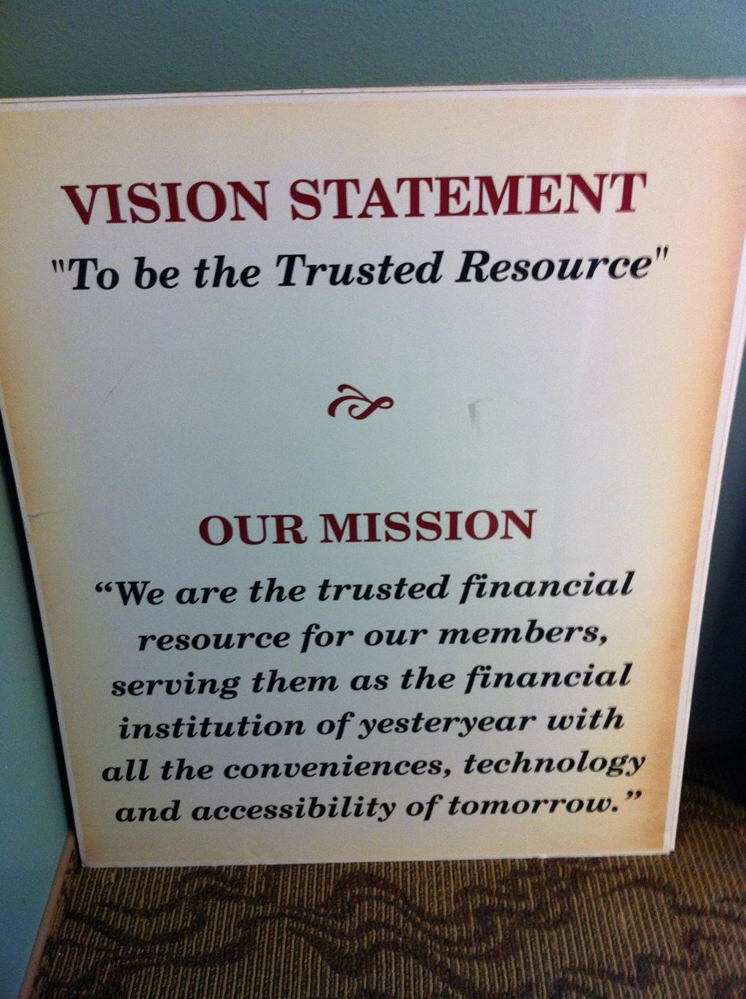
Notes:
here’s an example that makes us laugh...
This is consistent with our own research that the concepts of V-M are confused across all types organizations…
in this case, how is it that their Vision says “they will be,” and mission is that “they already are” how will that guide their work?

Slide 27
Mission (M)

Slide 28
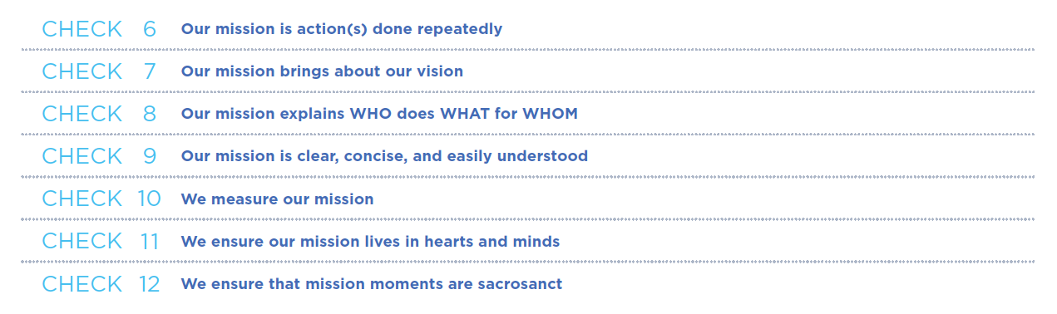
Mission
Notes:
Overview in context of M litmus’
Done repeatedly
Brings about Vision
Explains who does what for whom
Clear, concise, easily understood
Measureable
Lives in hearts and minds
Mission moments are precious.

Slide 29


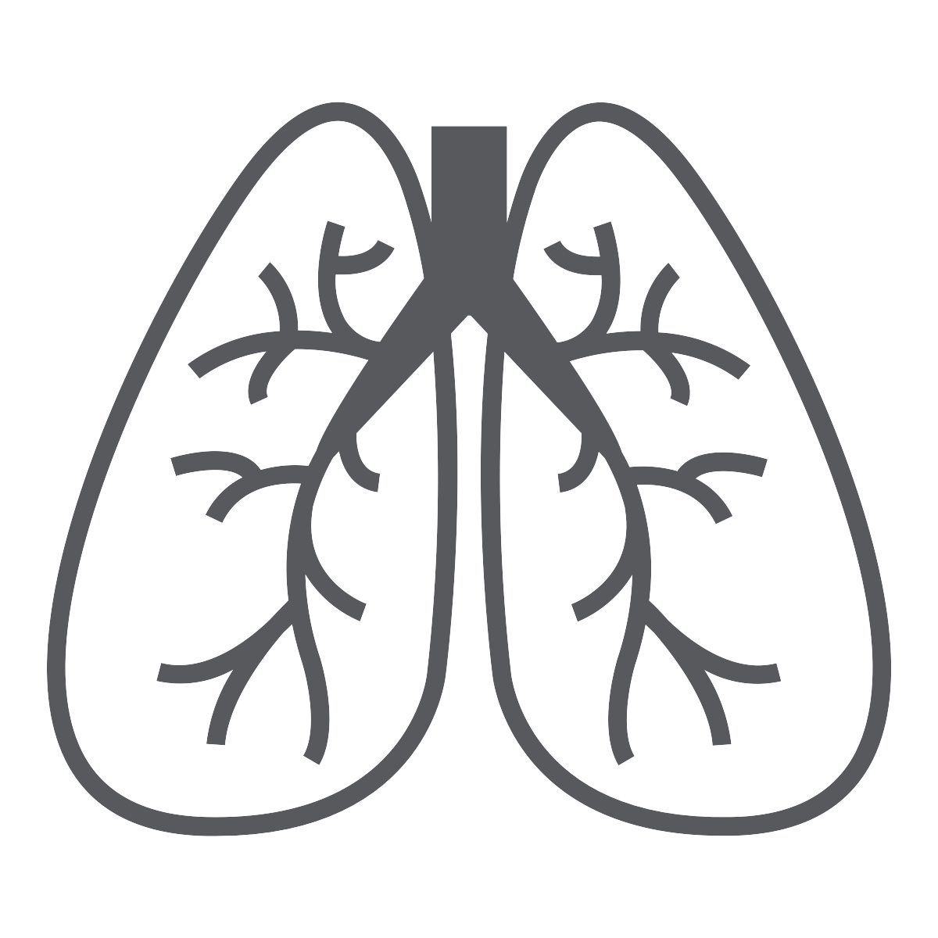











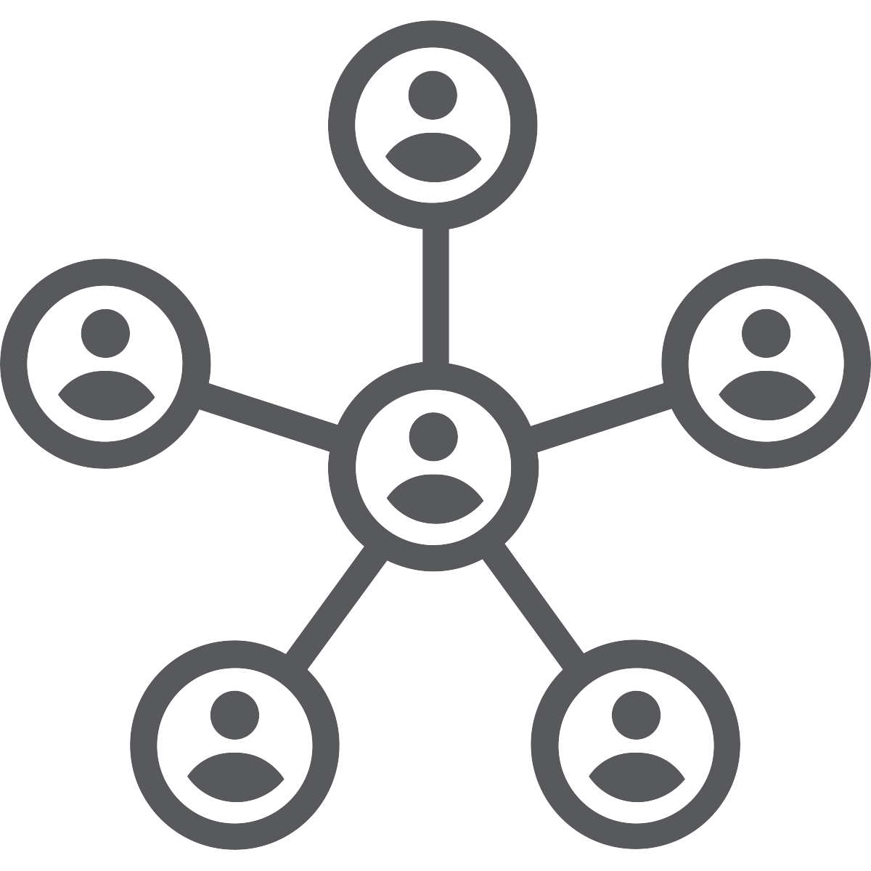
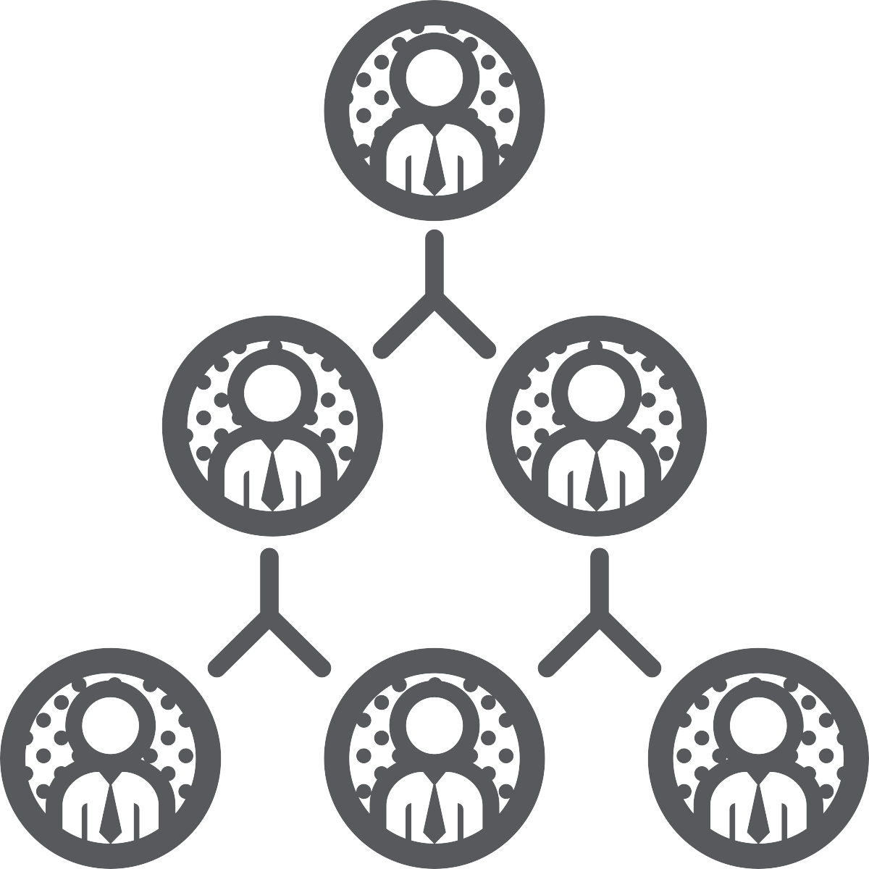
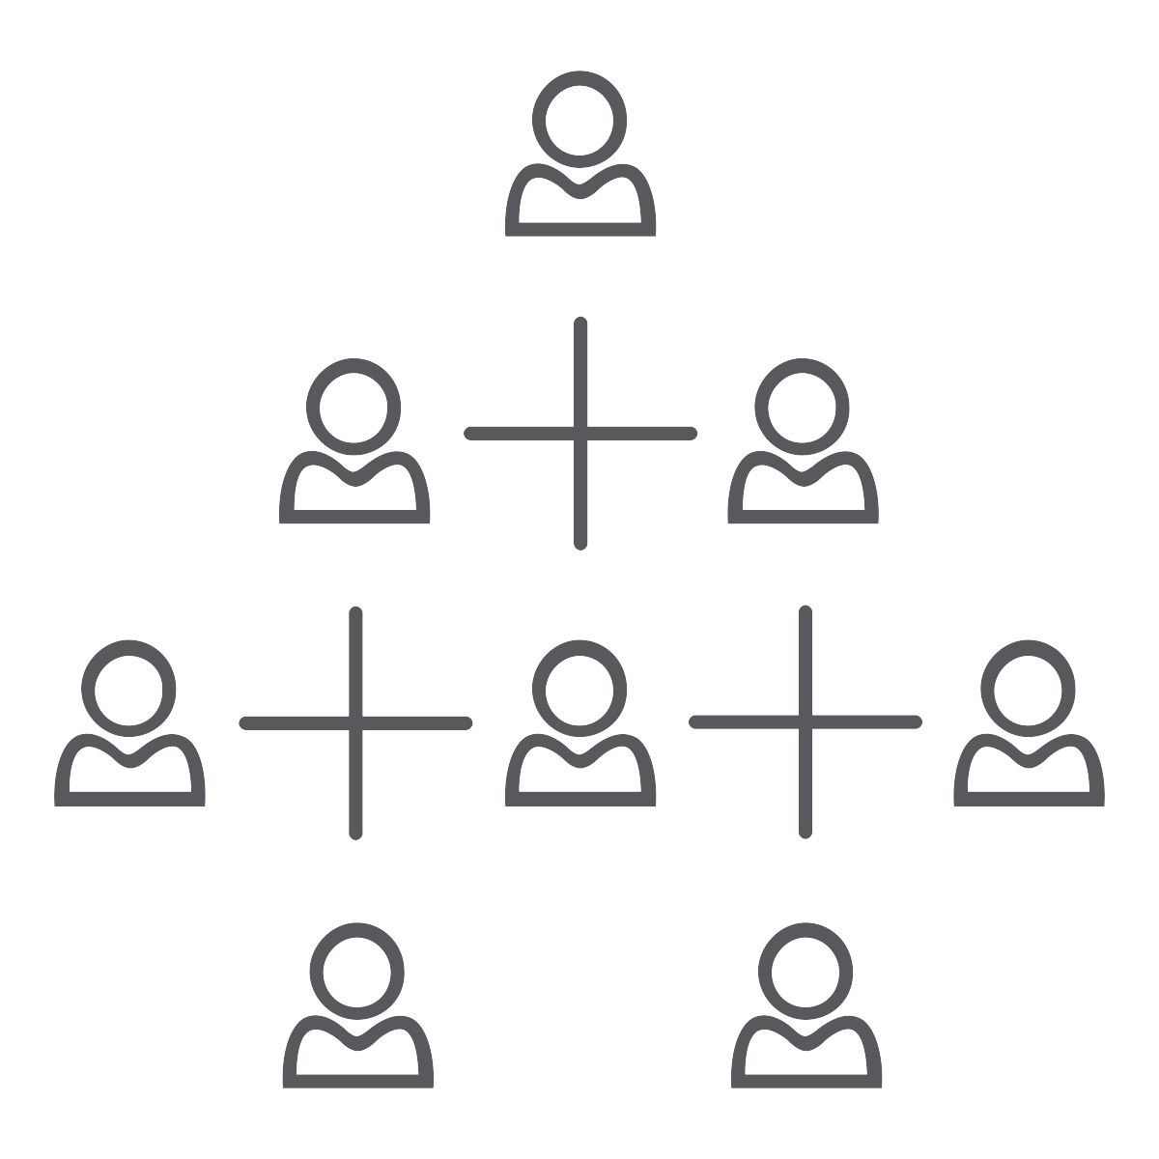



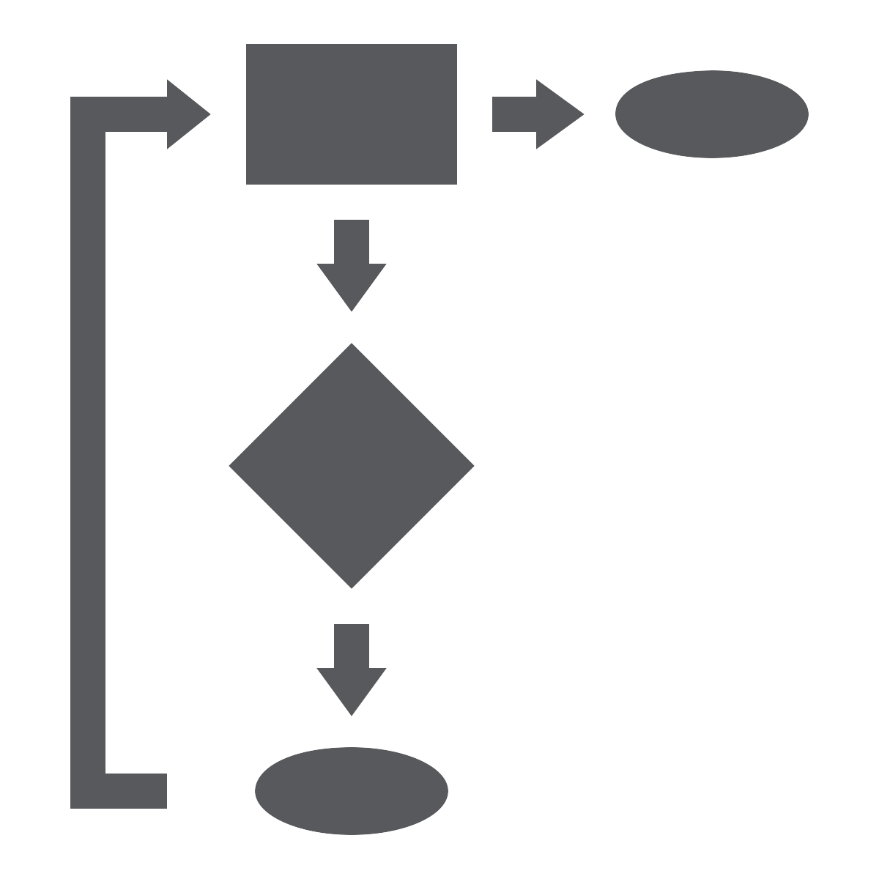

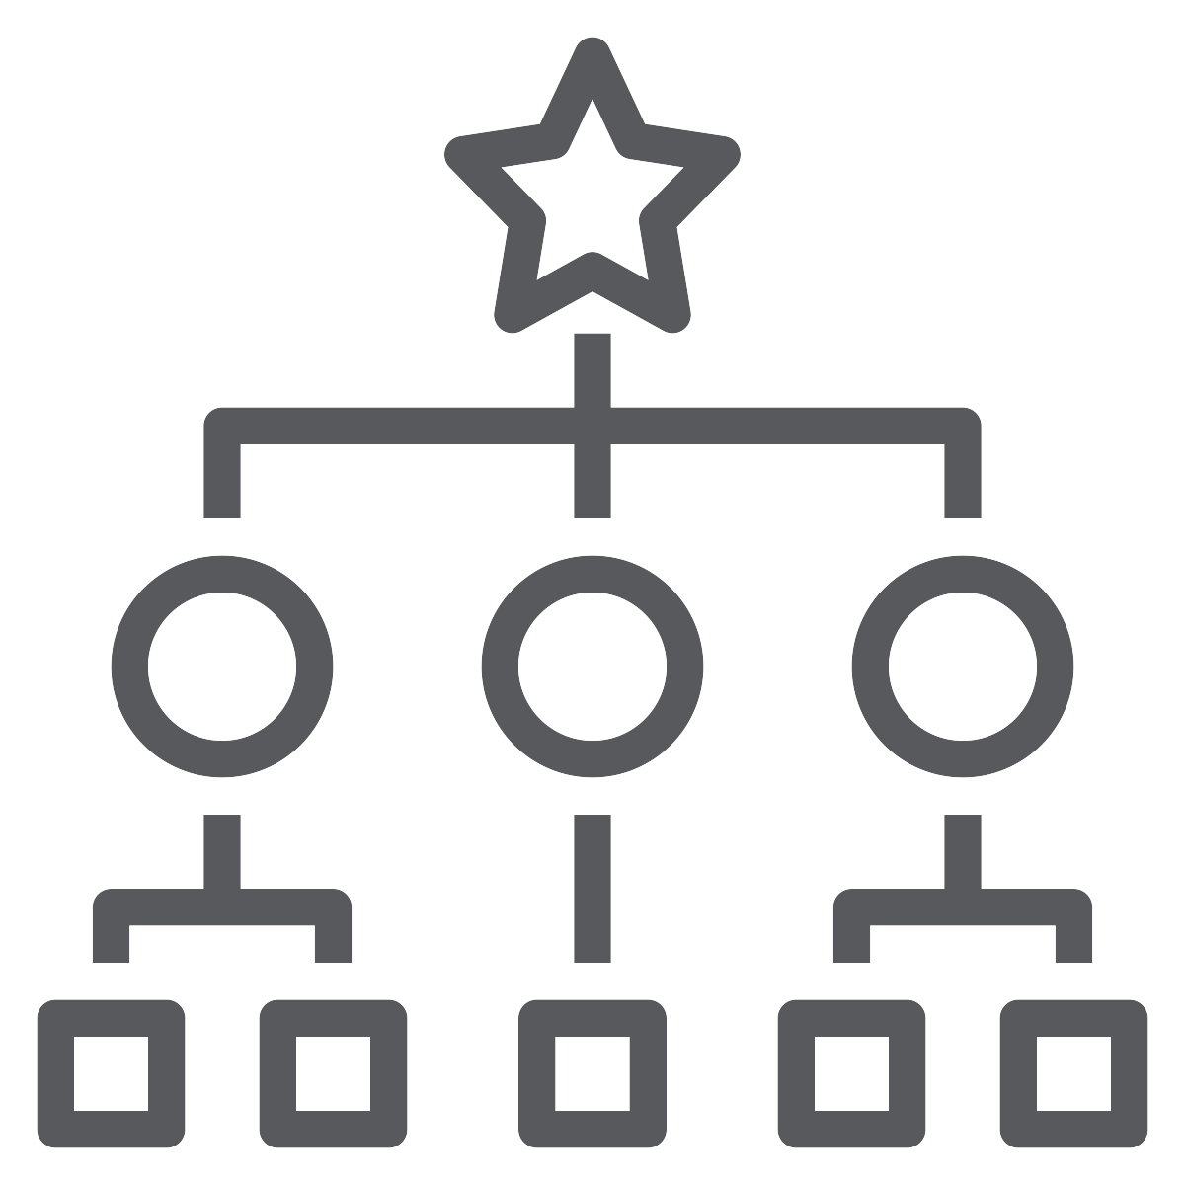
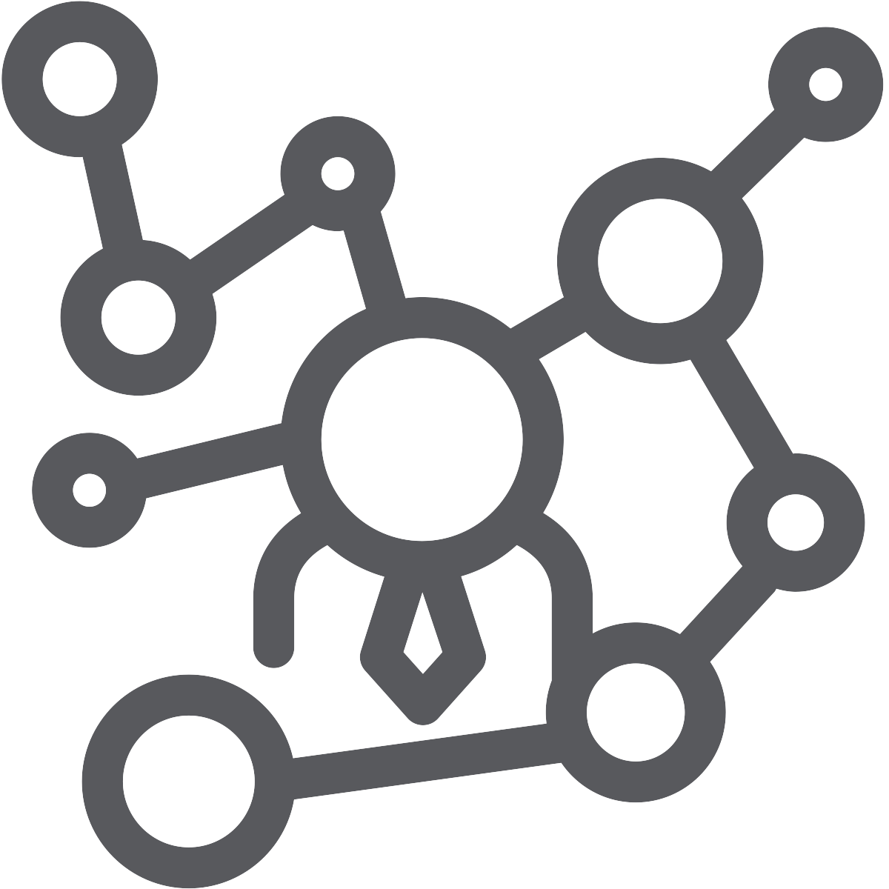
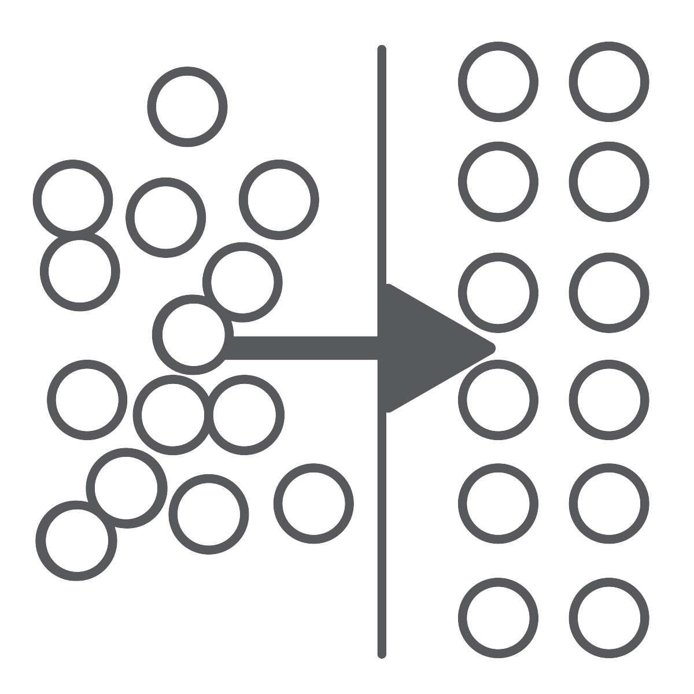
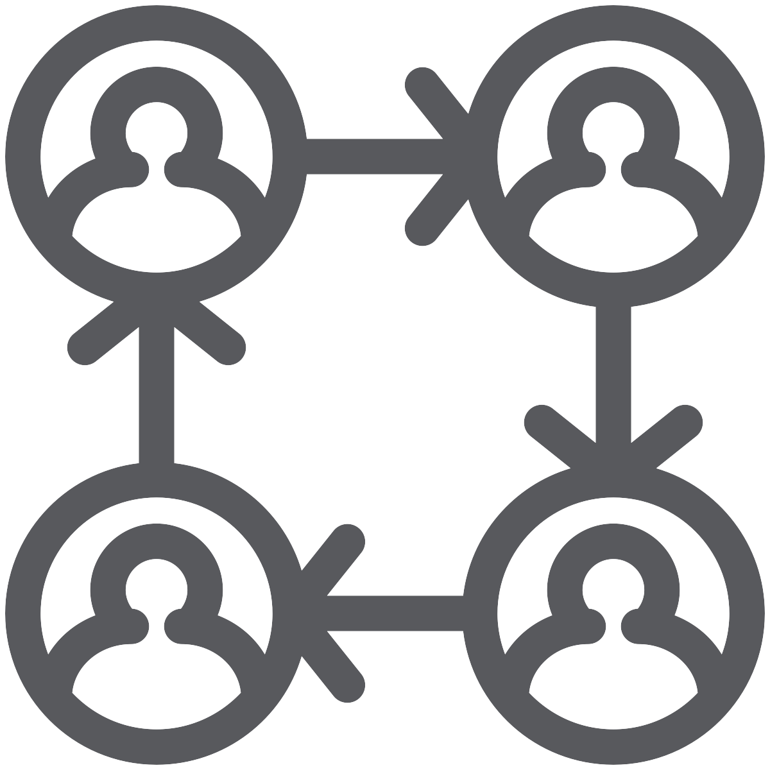
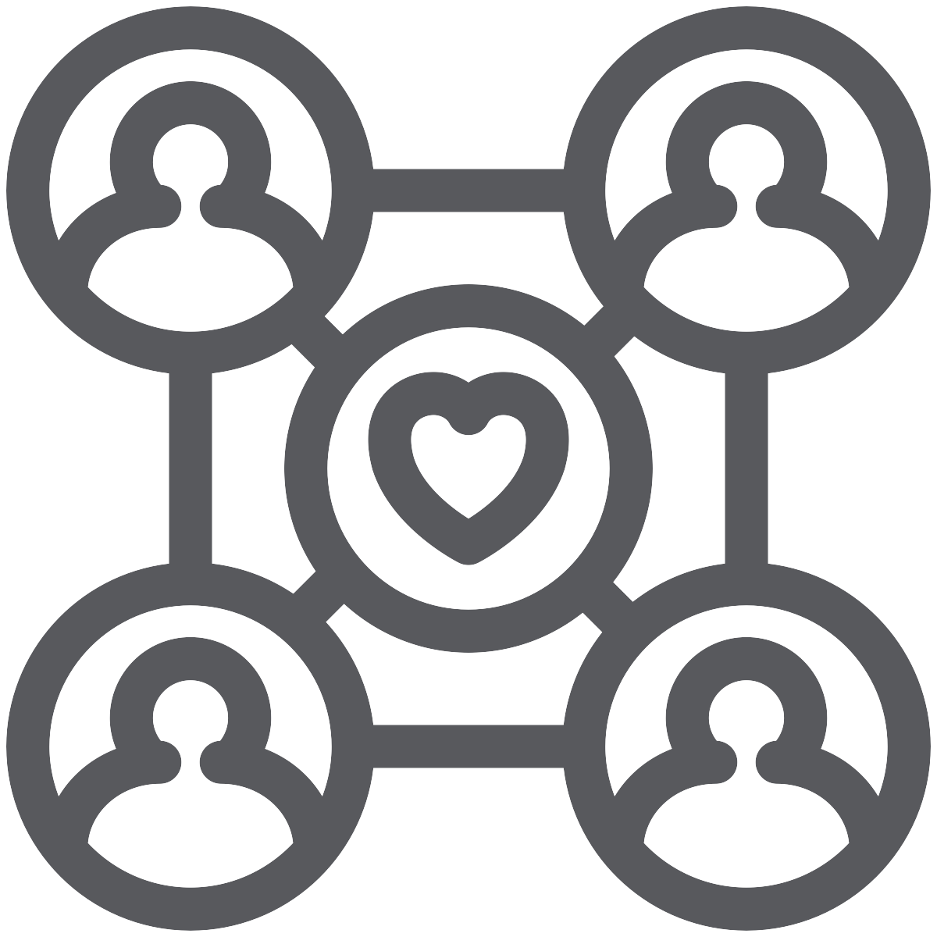
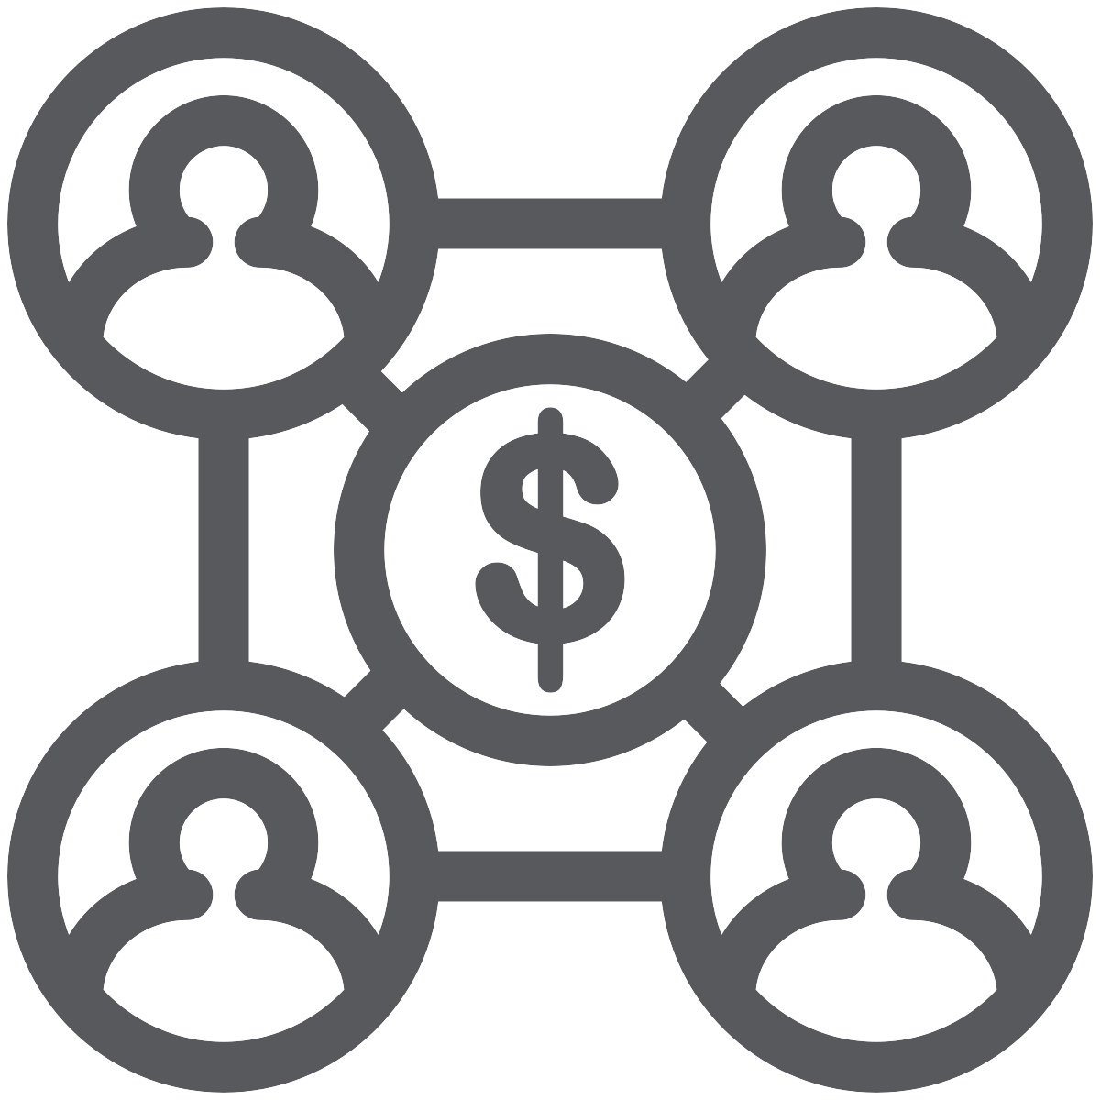


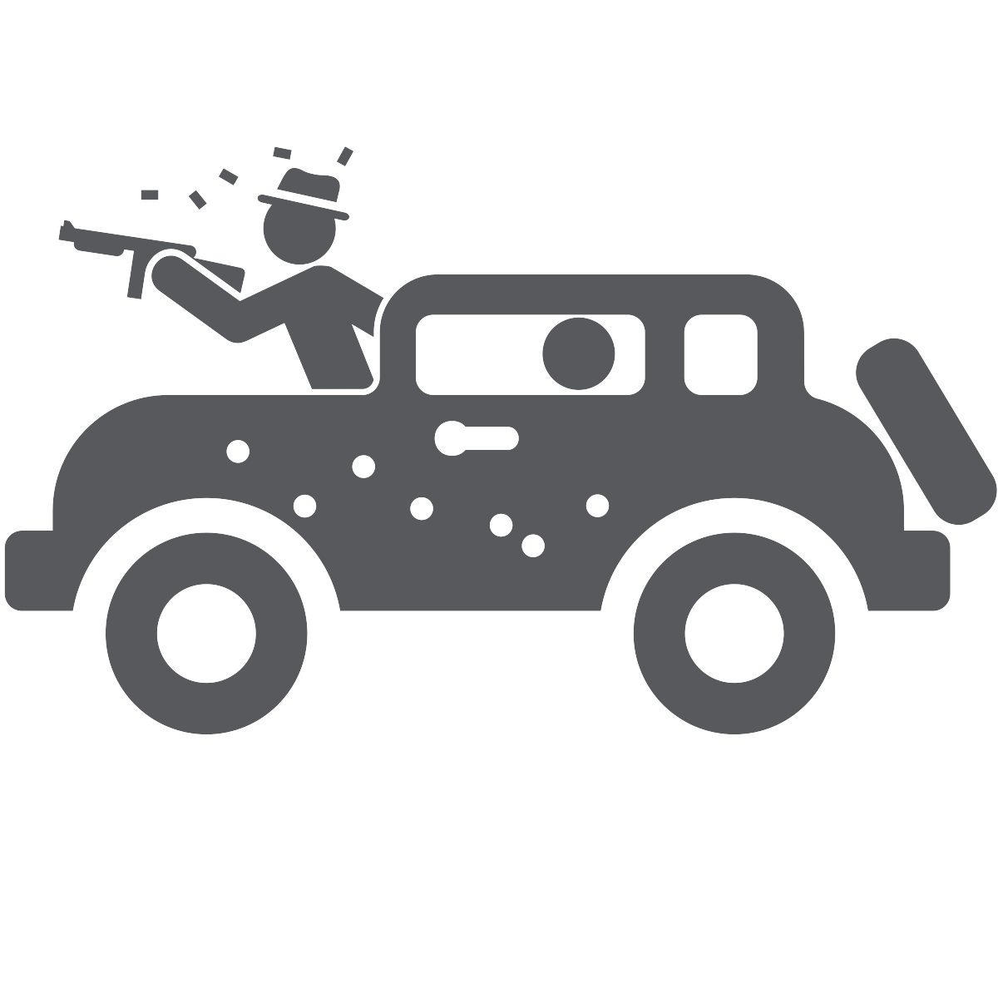
organelle
organ
organism
organization (n)
organization (verb)
to organize
Notes:
When you take a wider look at organization not as a noun, but as a verb, across natural and social systems…
what we see is not a HUMAN based definition of mission but an existential feature of organization itself.
VMCL are FUNCTIONS of all forms of organization from organs to organism to organizations.

Slide 30
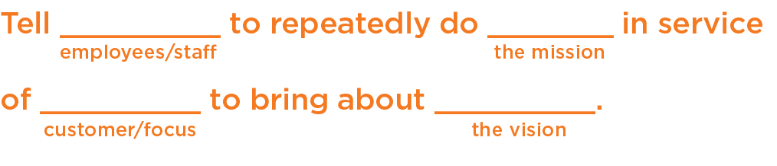
Mission Statement MadLib
Tell
employees
to repeatedly do
some thing
in service of
your customer
to bring about
your Vision
.
Notes:
Most importantly a good mission statement
Explains who does what for whom
And when done repeatedly - leads to your vision…
A few examples...

Slide 31

Notes:
Simple V-M,

Slide 32
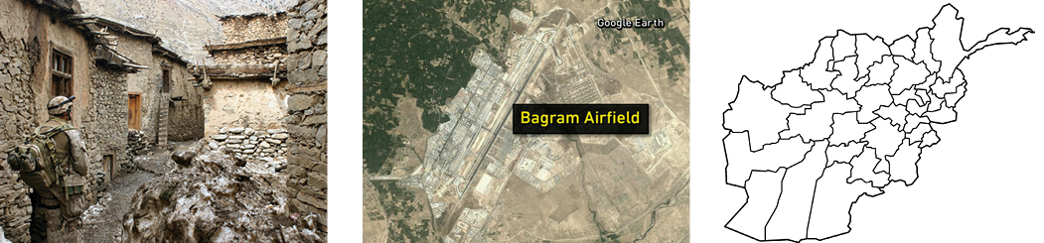
CLEAR. HOLD. BUILD THE VILLAGE
CLEAR. HOLD. BUILD THE AIRPORT
CLEAR. HOLD. BUILD THE PROVINCE
CLEAR. HOLD. BUILD.
Notes:
What he understood is that systems thinking isn’t just something that generals do to get the big picture, it’s something that all the agents (e.g., soldiers and commanders) do at every level in the organization.
He needed to help all the agents identify the simple rules that collectively led to the emergent properties they were all seeking.

Slide 33
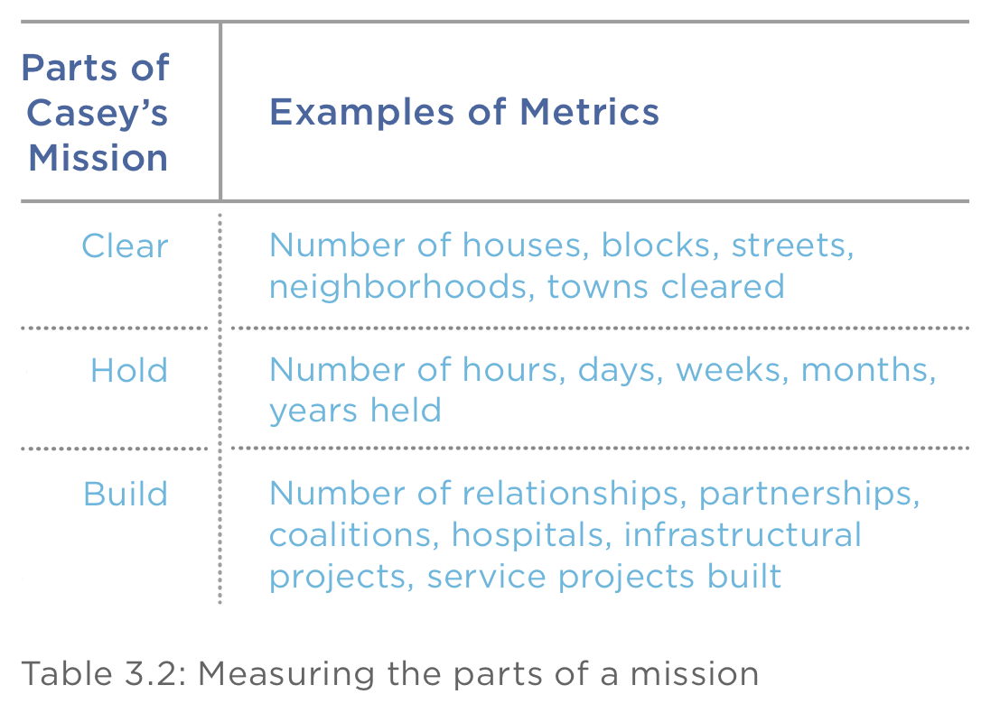
Notes:
And, a good Mission is Measurable, note here how we could assess the degree of success we were having in our efforts.

Slide 34
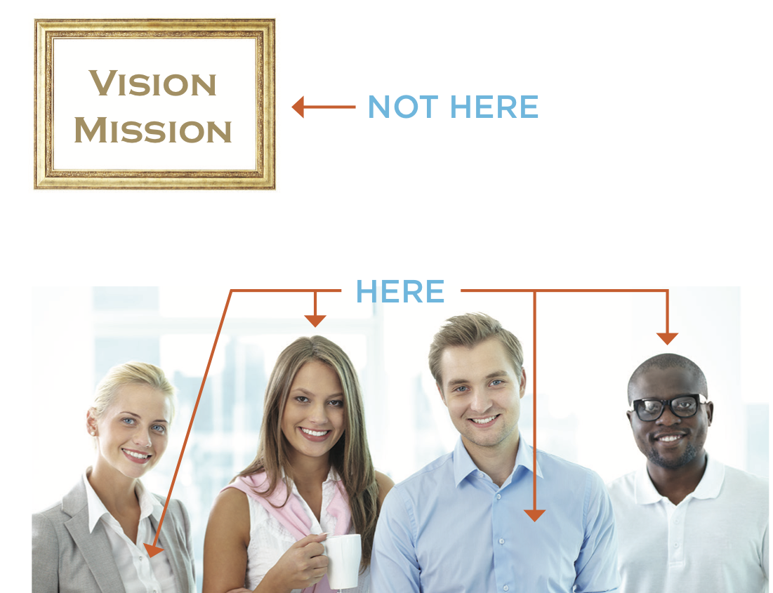
Notes:
Another important rule of good Vision-Missions is that they don’t live in frames and websites, But in the hearts and minds of everyone in your organization:

Slide 35
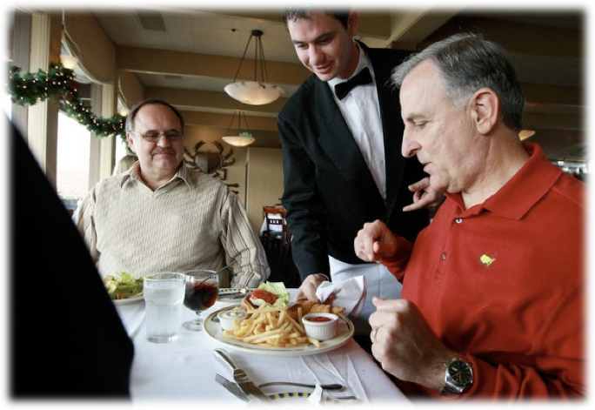
A Mission Moment
If ✔ then↑; if ✖ then↓
Notes:
Mission Moments are precious, and EVERY interaction with a client or customer must be treated as so.. Bc if you do mission moments well = more, goes poorly = less
Ultimate feedback example is a restaurant… if that meal isn’t good, he’s not coming back...

Slide 36
CAPACITY (C)

Slide 37
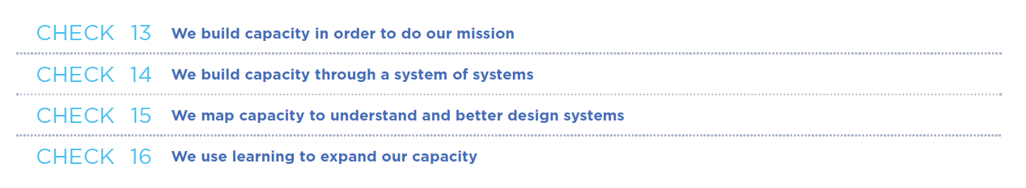
Notes:
Vision is what you SEE
Mission is what you DO
Capacity is state of readiness that allows us to do our mission
It’s a SYSTEM of SYSTEMS
We MAP capacity to understand and better design our systems
We use LEARNING to expand our capacity.

Slide 38
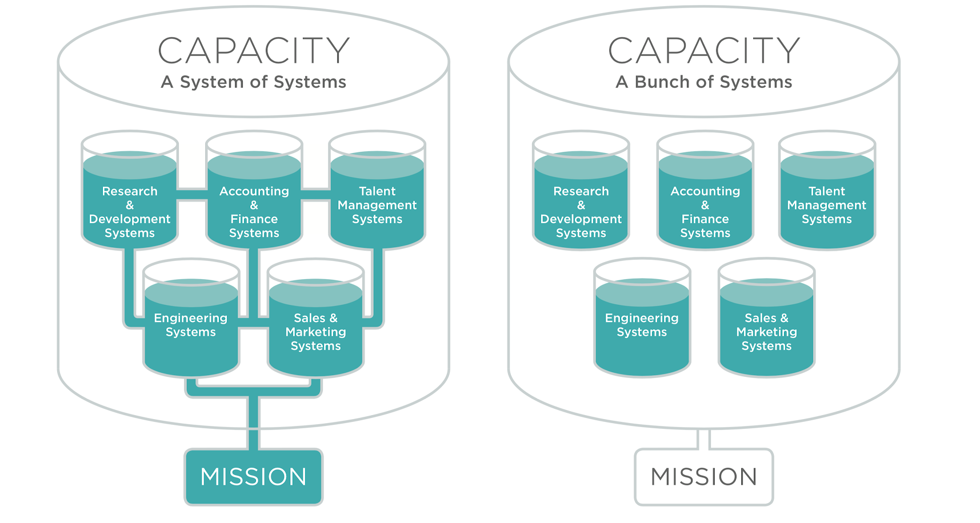
Notes:
It’s a SYSTEM of SYSTEMS tied to our mission
Systems that are NOT serving your mission should be questioned...

Slide 39
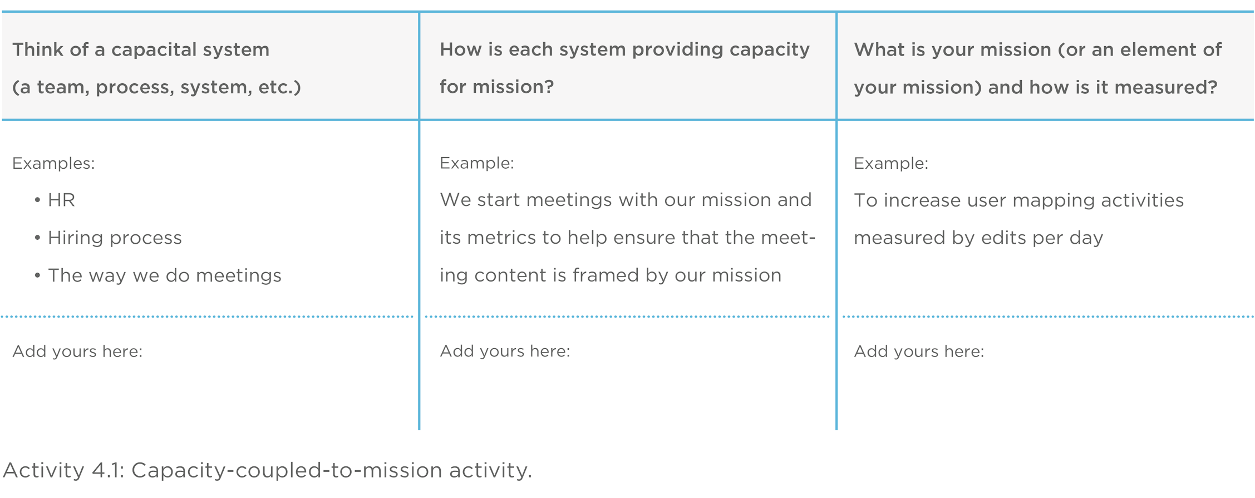
Notes:
So - When thinking about capacity...
Think about a capacital system in your org (a team, process or system)
Ask yourself how is each system providing capacity for mission?
Identify your mission moment and how can it’s success be measured?

Slide 40
An organization's ability to learn, and translate that learning into action rapidly, is the ultimate competitive advantage.
Jack Welch
Notes:
Organizational learning is what creates additional capacity
An organization's ability to learn, and translate that learning into action rapidly, is the ultimate competitive advantage.
and is the driver of an adaptive organization

Slide 41
LEARNING (L)

Slide 42
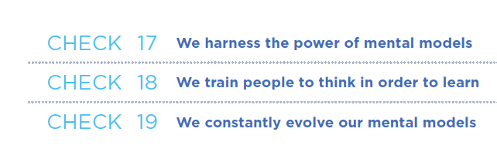
Notes:
We harness the power of mental models
We train people to think, in order to learn
We constantly evolve our mental models

Slide 43
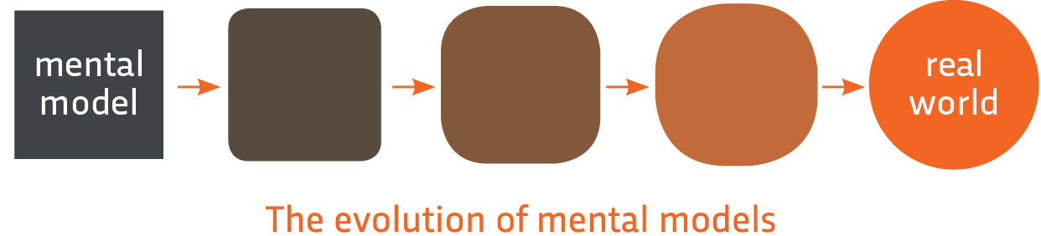

approximates
Real world systems
Mental Models
thinking (DSRP) (t)
+
Information (i)
informs
informs
We constantly evolve our mental models
Notes:
We do all of this to evolve our mental models to better align them with reality - which yields better results.

Slide 44
Organizational Function |  | Short definition
Vision (V) |  | Desired future state or goal
Mission (M) |  | Actions that in repetition lead to vision
Capacity (C) |  | Mission-critical systems that support vision
Learning (L) |  | Continuous modification of mental models (DSRP) based on feedback from the external environment
CULTURE |  | Shared mental models (VMCL) that drive organizational behavior
Notes:
So, that’s VMCL in a nutshell, but let’s not forget.
At the base of these functions is building CULTURE around them…
Shared mental models (VMCL) that drive organizational behavior...
Deming said, “Culture eats strategy.”
So, you have this thing which is totally important--maybe more important than strategy-- but its highly amorphous...

Slide 45

Notes:
While you may have employees, customers, partners coming and going at various times and rates, the culture of an organization somehow persists.
Where culture is concerned, success is always due to the sharing and diffusion of the mental models.
If you can harness culture, then you can truly harness the power of VMCL. And, if you don’t, then you have a few well written statements and a couple of maps.

Slide 46


Notes:
In the book, we offer a checklist for creating your own VMCL...

Slide 47
END

Slide 48

Vision: Living Healthy is the New Normal
Mission: Facilitate and Motivate Healthy Habits
Notes:
Here’s an example of a powerful, short Vision and Mission that transformed My Fitness Pal.
Laura and I hosted their executive team a few years ago,as they were facing enormous growth (they have since been purchased by under armour) and they needed to coalesce their team and the entire organization around a shared, motivating Vision & Mission.
Over a couple of days, it turned out that the thing that bothered the Execs the most, was that it was very difficult for people to live healthfully….

Slide 49




Vision Statement:
Living Healthy is the New Normal
Mission Statement:
Facilitate and Motivate Healthy Habits
Mental Model of Mission
Mental Model of Vision
Living Healthy is the New Normal
Facilitate and Motivate Healthy Habits
Notes:
Vision and Mission are mental models
Well here’s an illustration of the meaning of their Vision-Mission that was built at our offsite.
What you should notice is that articulating the underlying structure of each piece of the Vision and Mission leads to a SHARED and DEEP understanding among ALL members of the organization.
It’s that clarity of meaning that energizes and focuses all of your systems (human and otherwise) in the right direction to maximize the desired impact you seek.

Slide 50

Notes:
But what we will review covers two books, and two semester long graduate courses.

